Slide 1

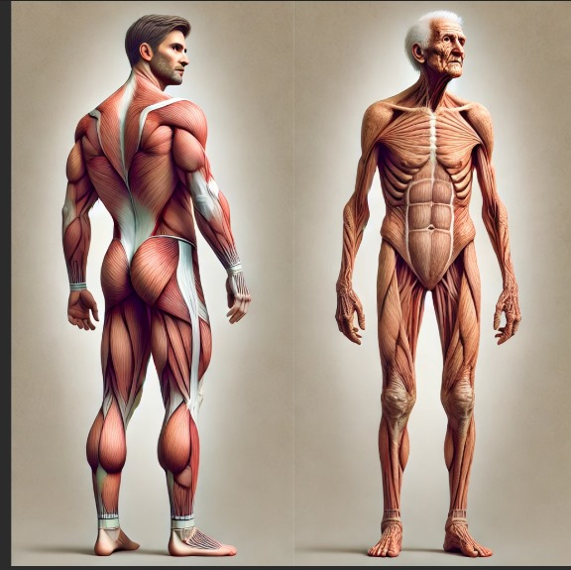
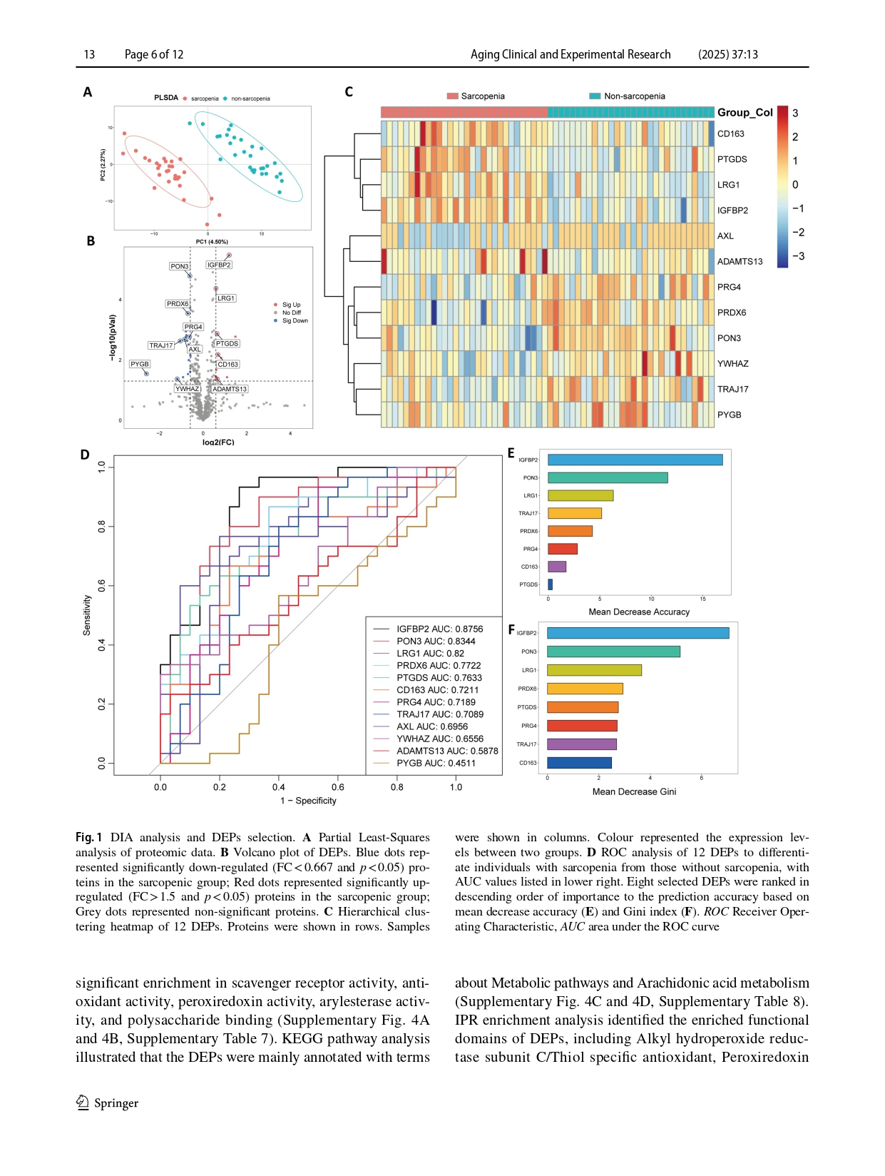
Decoding Sarcopenia Plasma Biomarkers Through Proteomic Analysis
Qinqing Lin, Kangyong Li, Liwei Li, Lichang Guan, Yingtong Zeng, Dake Cai, Jing Zhou, Lishu Xu
Department of Geriatric Gastroenterology, Guangdong Provincial People’s Hospital (Guangdong Academy of Medical Sciences), Southern Medical University, Guangzhou, China
Introduction
Methods
Sarcopenia is a condition that causes the gradual loss of muscle mass, strength, and function as people age. It affects older adults, leading to frailty, difficulty in movement, and a higher risk of falls and disability The condition is influenced by aging, chronic diseases, and lifestyle factors. Identifying biomarkers through proteomics, the study of proteins in the blood, can help detect sarcopenia early, monitor its progression, and guide treatment options to improve the health and quality of life for older adults.
. Participant Selection: A total of 72 participants were enrolled, including 30 diagnosed with sarcopenia and 30 without, plus 12 for validation.
Sample Collection: Blood samples were collected after fasting, and plasma was obtained through centrifugation.
Proteomic Analysis: Data-Independent Acquisition (DIA) and Enzyme-Linked Immunosorbent Assay (ELISA) were utilized for protein quantification
Objective: This study aims to identify potential biomarkers for sarcopenia through proteomic analysis, focusing on the differential expression of proteins in individuals with and without sarcopenia.
Key Findings:
Differentially Expressed Proteins DEPs
A total of eight DEPs were identified, including IGFBP2, PON3, LRG1, PRDX6, PTGDS, CD163, PRG4, and TRAJ17.
PON3 was significantly down-regulated in older adults with sarcopenia, suggesting its role in impaired antioxidant defenses.
Statistical Significance:
The study found significant differences in protein expression levels between sarcopenic and non-sarcopenic groups, with p-values indicating strong statistical significance (e.g., p < 0.001 for PON3).
ROC Analysis:
The Receiver Operating Characteristic (ROC) curve analysis demonstrated an Area Under the Curve (AUC) of 0.9533, indicating excellent predictive capability for sarcopenia based on the identified DEPs.
Clinical Correlations:
Positive correlations were observed between appendicular skeletal muscle index (ASMI), grip strength, and walk speed with proteins such as PRDX6, PON3, and TRAJ17.
Inverse correlations were noted with PTGDS, CD163, LRG1, and IGFBP2, highlighting their ion.
Figure 1: Volcano Plot of DEPs
This figure illustrates the significant up-regulated (red) and down-regulated (blue) proteins, providing a visual representation of the differential expression.
Figure 2: Hierarchical Clustering Heatmap
The heatmap displays the expression levels of DEPs across the samples, allowing for the visualization of clustering patterns between sarcopenic and non-sarcopenic individuals.
Figure 3: ROC Curve Analysis
The ROC curve demonstrates the predictive accuracy of selected DEPs for diagnosing sarcopenia, with the AUC indicating the model's effectiveness.
Conclusion
This study highlights the potential of specific proteins, particularly PON3 and IGFBP2, as biomarkers for sarcopenia. The findings underscore the importance of proteomic analysis in understanding the biological underpinnings of sarcopenia and the need for further validation of these biomarkers in diverse populations.
Discussion
The identification of PON3 as a potential biomarker for sarcopenia suggests that oxidative stress may play a critical role in the pathogenesis of this condition
Limitations: The cross-sectional design limits the ability to draw causal inferences
Future Directions
Longitudinal studies are needed to track changes in biomarker levels over time and their relationship with sarcopenia progression.
Further research should explore the underlying mechanisms of protein modifications and their impact on muscle health.
References:
Cruz-Jentoft, A. J., & Sayer, A. A. (2019). Sarcopenia. The Lancet.
Moqri, M., Herzog, C., Poganik, J. R., et al. (2023). Biomarkers of aging for the identification and evaluation of longevity interventions.
Contact Information:
[MOHSIN NAZIR BHAT]
[EMAIL ID] : mohsinnazir.bhat@studio.unibo.it ]

